Slide 1
Improved Source of Drinking Water
CAPSTONE PROJECT
Presented By:
Student Name- Lakshya Kumar
College Name- Haridwar University
Department- CSE AIML

Slide 2
OUTLINE
Problem Statement (Should not include solution)
Proposed System/Solution
System Development Approach (Technology Used)
Algorithm & Deployment
Result (Output Image)
Conclusion
Future Scope
References

Slide 3
Problem Statement
Access to safe and improved drinking water remains a major challenge in India, particularly in rural, remote, and socio-economically disadvantaged regions. Despite national initiatives and progress under the Sustainable Development Goals (SDGs), significant inequalities persist across states and population groups. Limited access to improved drinking water sources not only affects public health but also influences living standards, migration patterns, and the adoption of clean cooking fuels.
This project focuses on analyzing data from the 78th Round of the Multiple Indicator Survey (MIS) to evaluate the proportion of the population with access to improved drinking water sources. Additionally, it examines related socio-economic indicators such as the use of clean cooking fuel and migration trends to understand broader developmental linkages. The absence of granular, data-driven insights makes it difficult for policymakers to identify high-risk regions and prioritize interventions effectively.
The problem, therefore, lies in the lack of integrated analytical assessment that highlights regional disparities, underlying patterns, and correlations between water access and associated socio-economic factors. Addressing this gap through systematic data analysis can support evidence-based policymaking aimed at ensuring equitable and sustainable access to safe drinking water for all.

Slide 4
Proposed Solution
The proposed solution leverages IBM Cloud and watsonx.ai Studio to develop a data-driven analytical system that evaluates access to improved drinking water sources across India. Using data from the 78th Round of the Multiple Indicator Survey (MIS), the system performs exploratory data analysis and AI-assisted insights generation to identify regional disparities and socio-economic patterns related to drinking water availability.
The solution integrates multiple indicators—including access to improved drinking water, use of clean cooking fuel, and migration trends—to uncover correlations and hidden trends that influence water accessibility. Watsonx.ai Studio is utilized for data preprocessing, visualization, and intelligent analysis, enabling efficient handling of large-scale survey data and automated insight generation.
By deploying the analytical workflow on IBM Cloud, the solution ensures scalability, reliability, and secure data management. The results are presented through interactive dashboards and summarized insights that allow policymakers, researchers, and stakeholders to easily identify high-risk regions and priority areas for intervention.
Overall, this solution transforms raw survey data into actionable intelligence, supporting evidence-based policymaking aimed at reducing inequalities and ensuring equitable, sustainable access to safe drinking water across all regions of India.

Slide 5
System Approach
Input:
78th Round Multiple Indicator Survey (MIS) data on access to improved drinking water sources, clean cooking fuel usage, migration patterns, and socio-economic indicators across Indian states
Process:
Data cleaning, preprocessing, feature selection, and integration using Watsonx AI Studio on IBM Cloud, followed by exploratory and statistical analysis
Analysis:
Assessment of state-wise and socio-economic disparities, identification of patterns in access to improved drinking water, and correlation with clean cooking fuel usage and migration trends
Output:
Data-driven insights on inequalities in drinking water access and supporting indicators, with evaluation of India’s progress toward relevant SDG targets (SDG 6 & SDG 7)
Outcome:
Evidence-based recommendations to support inclusive water resource planning and policy interventions aimed at ensuring equitable access to safe drinking water across regions

Slide 6
Algorithm & Deployment
Algorithm
Preprocess MIS (78th Round) data related to access to improved drinking water sources
Clean, normalize, and integrate socio-economic indicators, clean cooking fuel usage, and migration data
Perform exploratory data analysis and statistical modeling
Apply regression and correlation analysis to identify disparities and trends
Analyze state-wise and demographic patterns aligned with SDG 6 (Clean Water and Sanitation)
Deployment on IBM Cloud
Store raw and processed datasets in IBM Cloud Object Storage
Conduct data analysis and model development using Watsonx AI Studio (IBM Watson Studio)
Deploy analytical models and insights as APIs using IBM Cloud Functions
Create interactive visualizations and dashboards using IBM Cognos Analytics to communicate insights

Slide 7
IBM CLOUD SERVICES USED
IBM Cloud Watsonx AI Studio
IBM Cloud Watsonx AI Runtime
IBM Watsonx Machine Learning Auto Agent
IBM Cloud Agent Lab

Slide 8
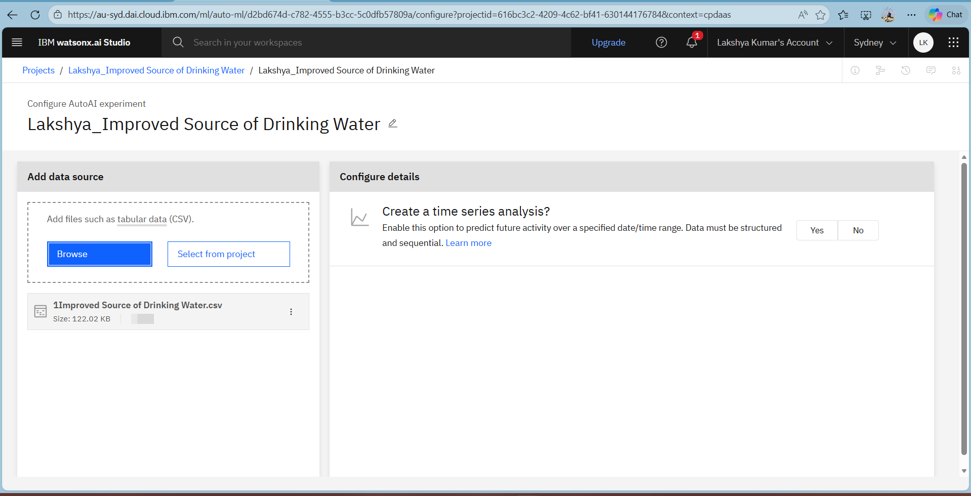
Result

Slide 9
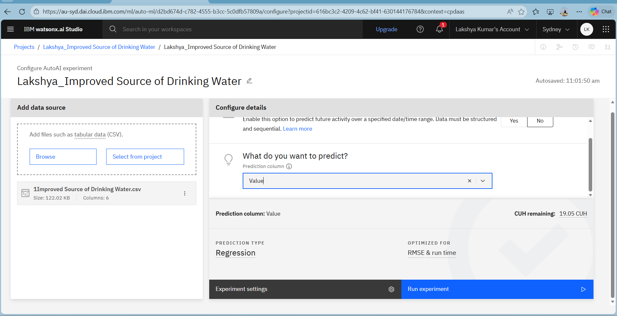
Result

Slide 10
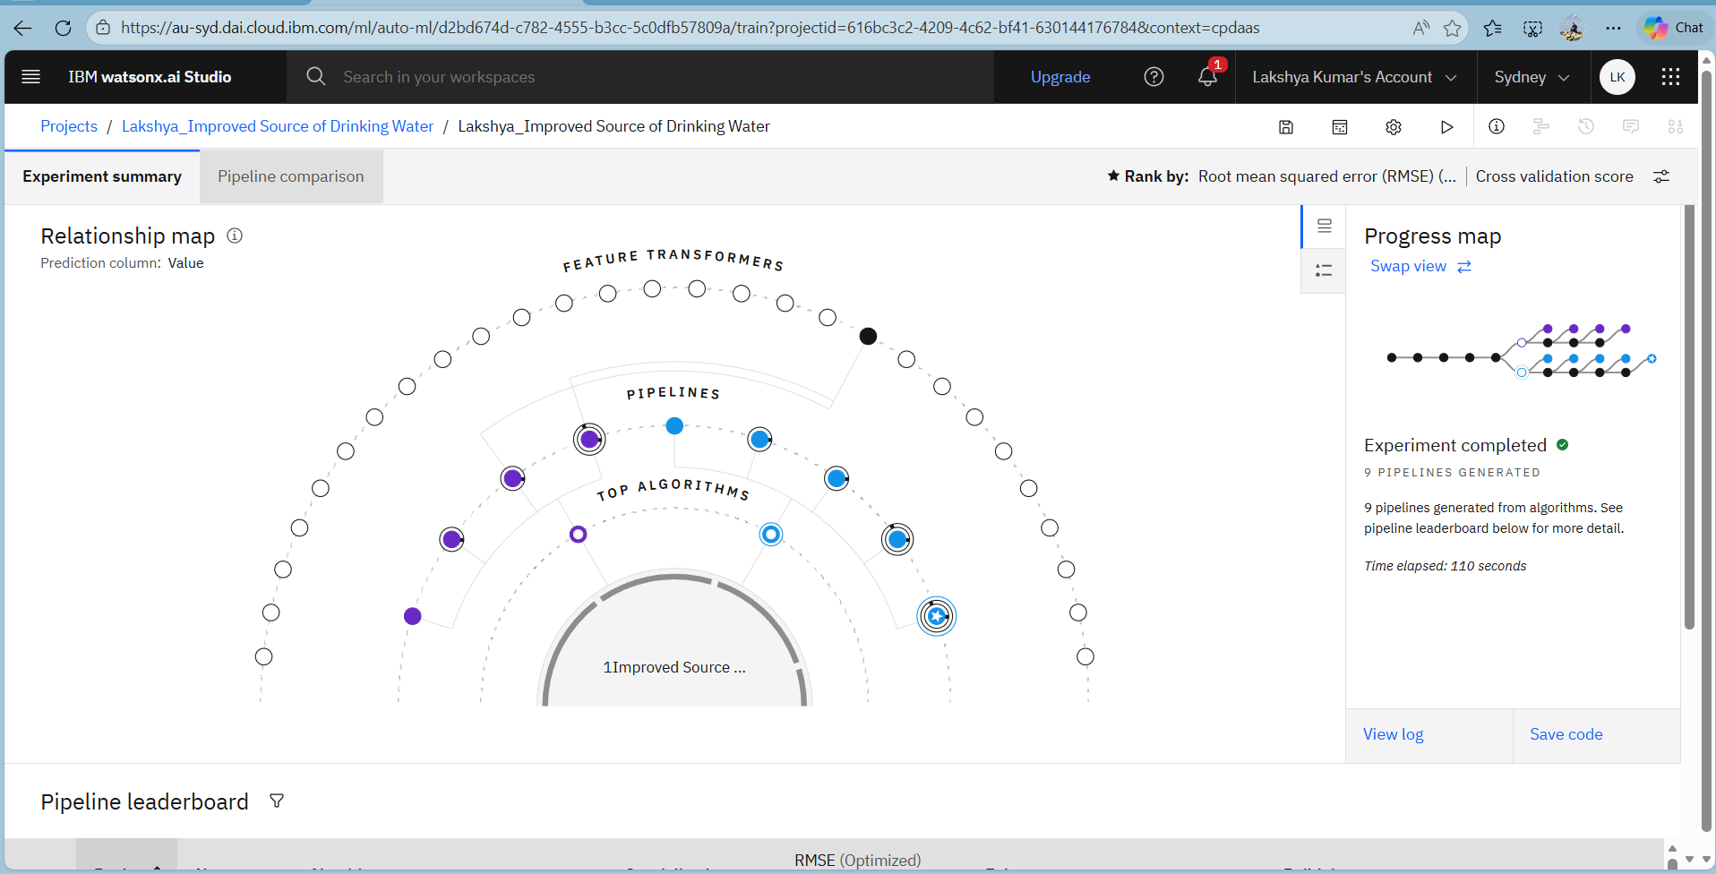
Result

Slide 11
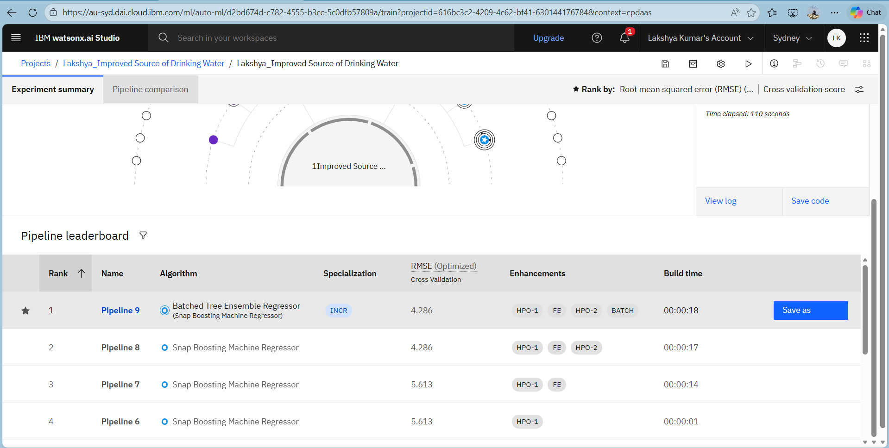
Result

Slide 12
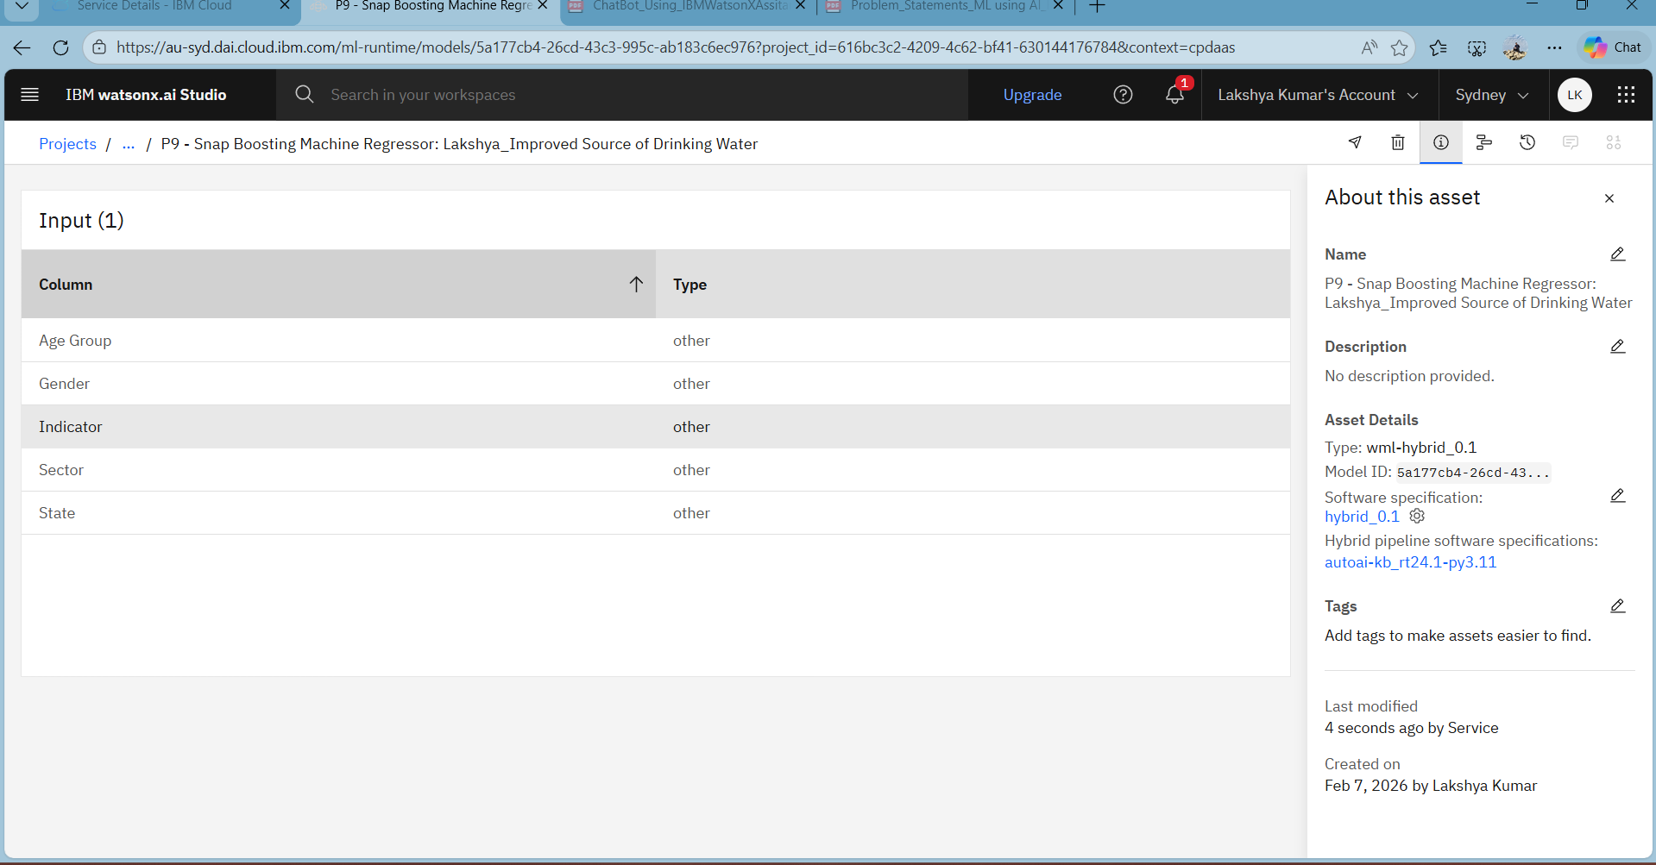
Result

Slide 13
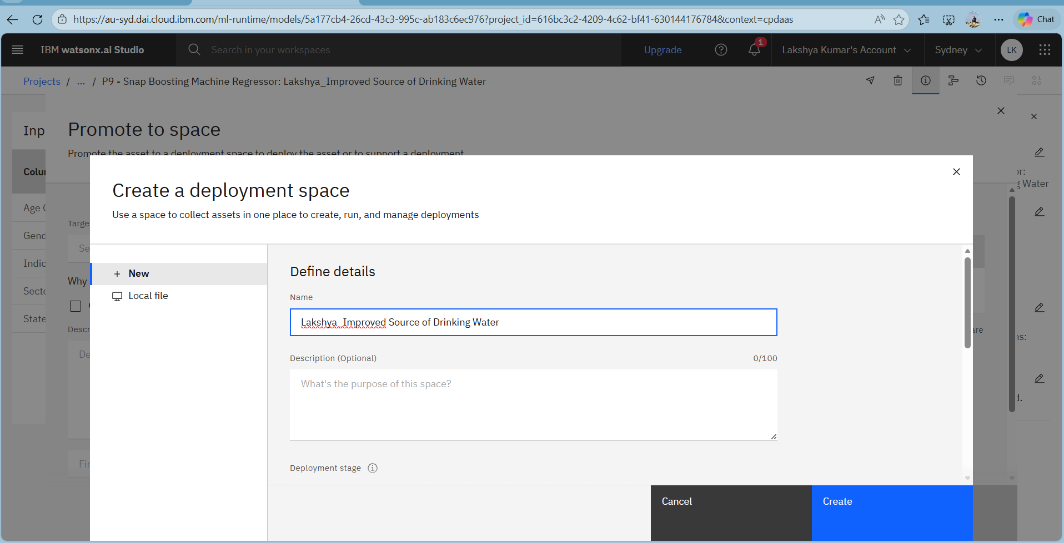
Result

Slide 14
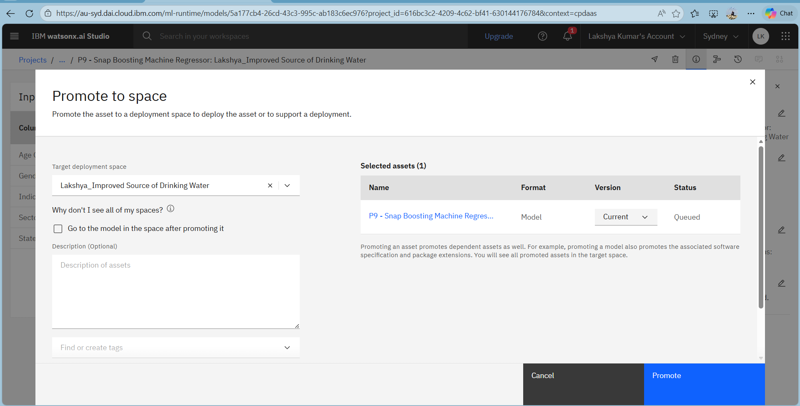
Result

Slide 15
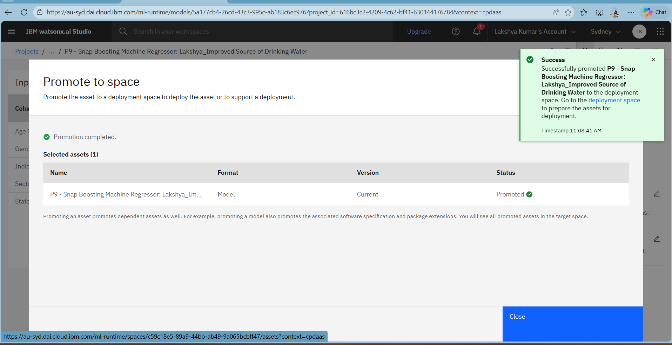
Result

Slide 16
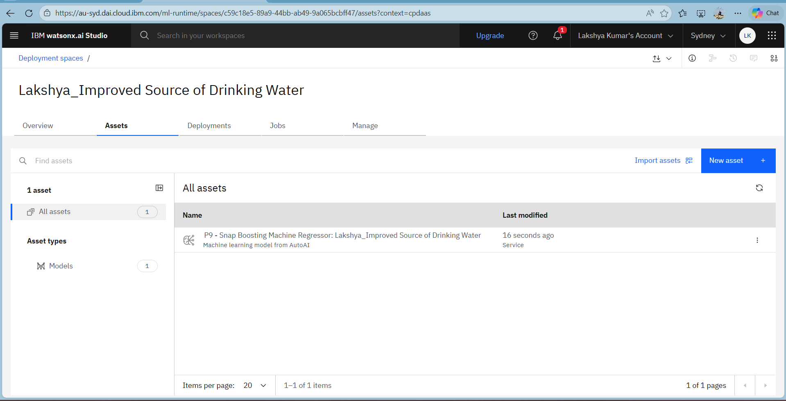
Result

Slide 17
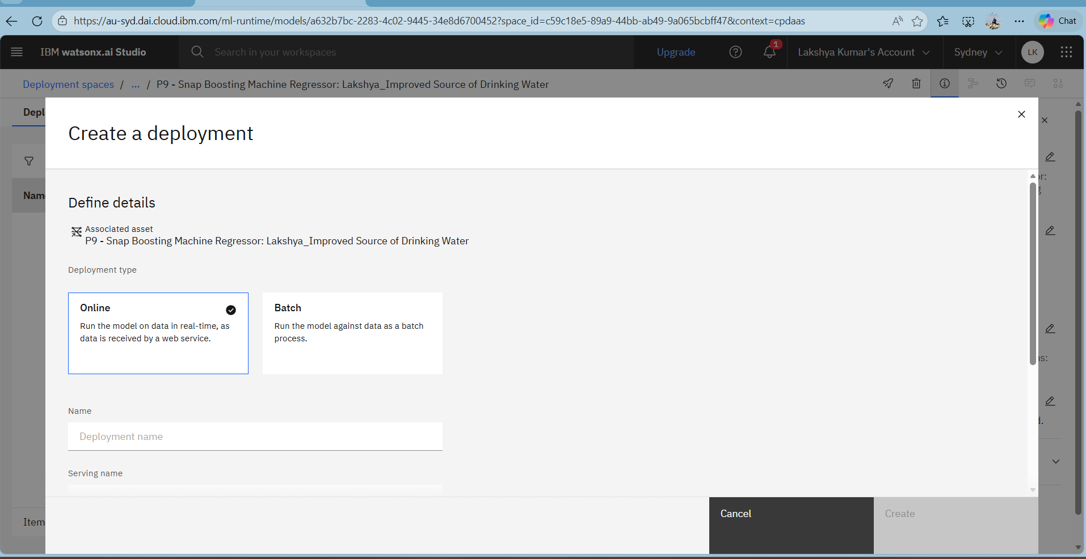
Result

Slide 18
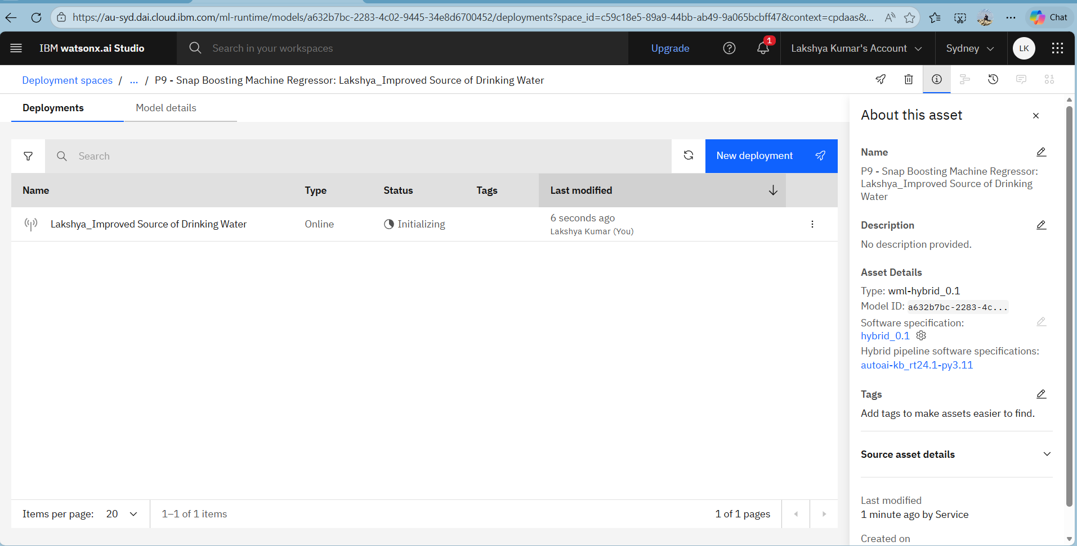
Result

Slide 19
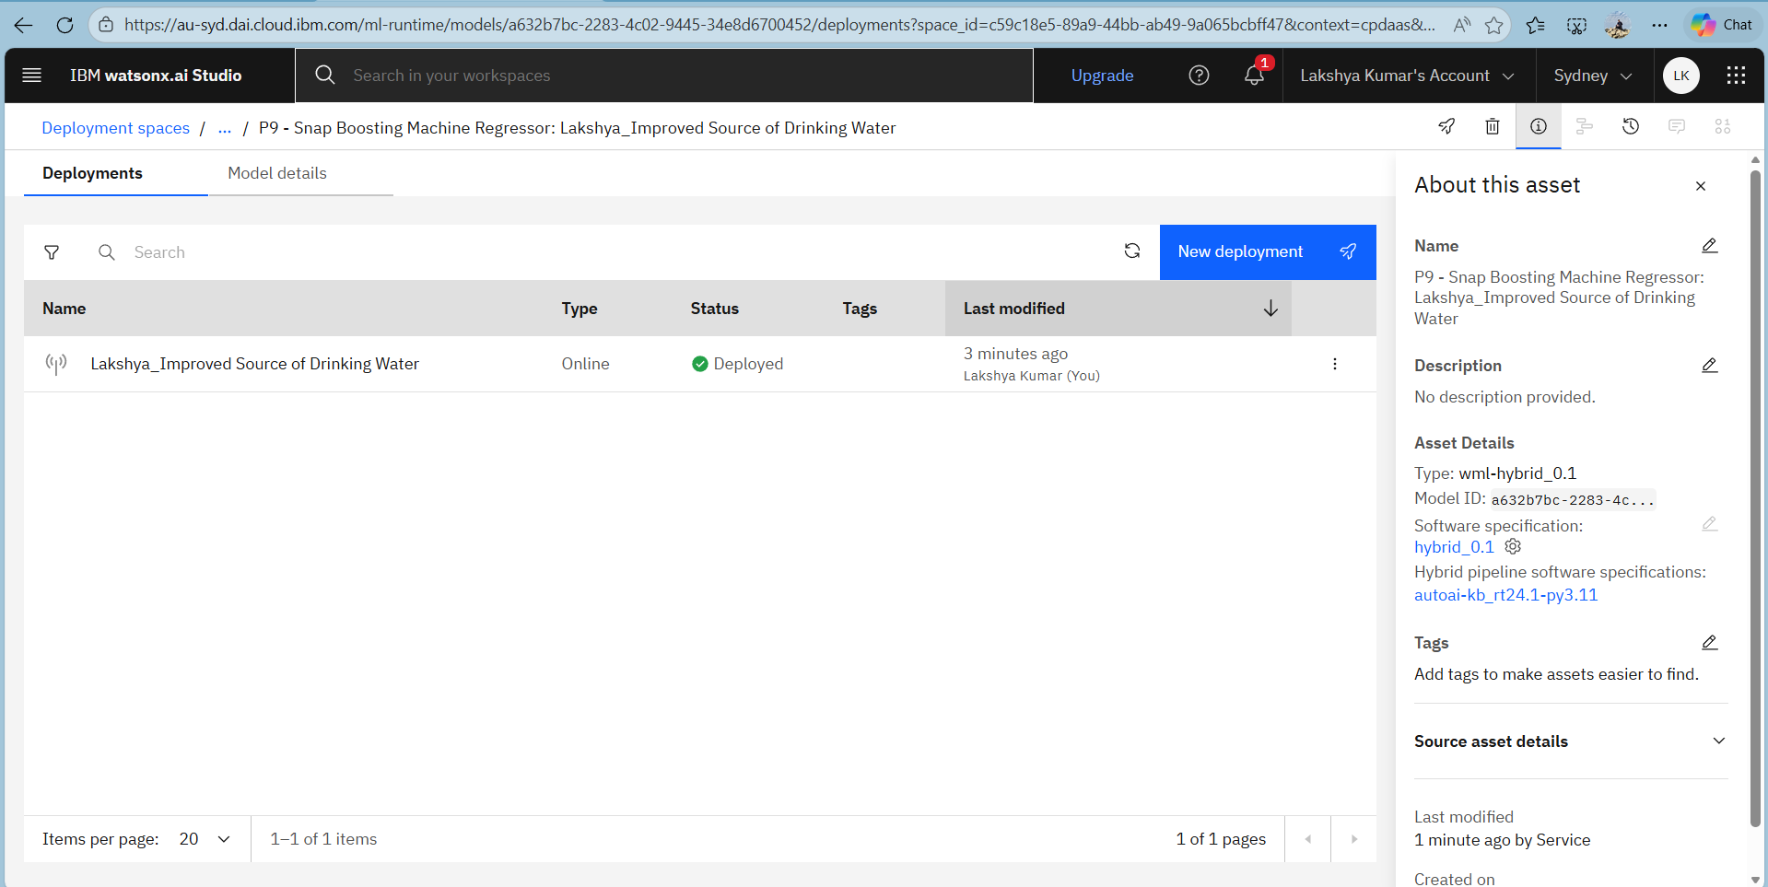
Result

Slide 20
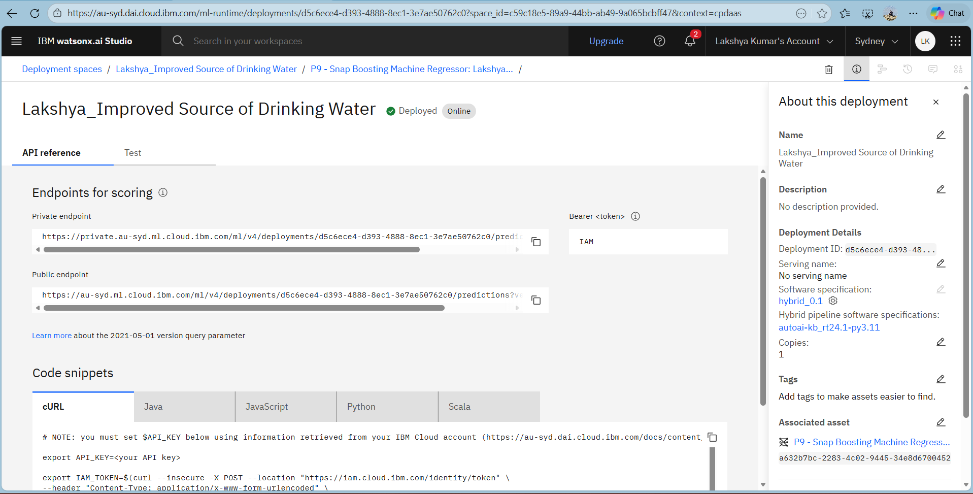
Result

Slide 21
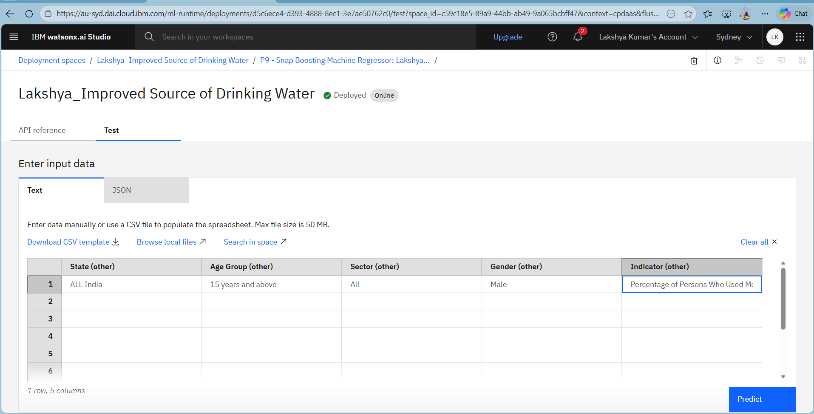
Result

Slide 22
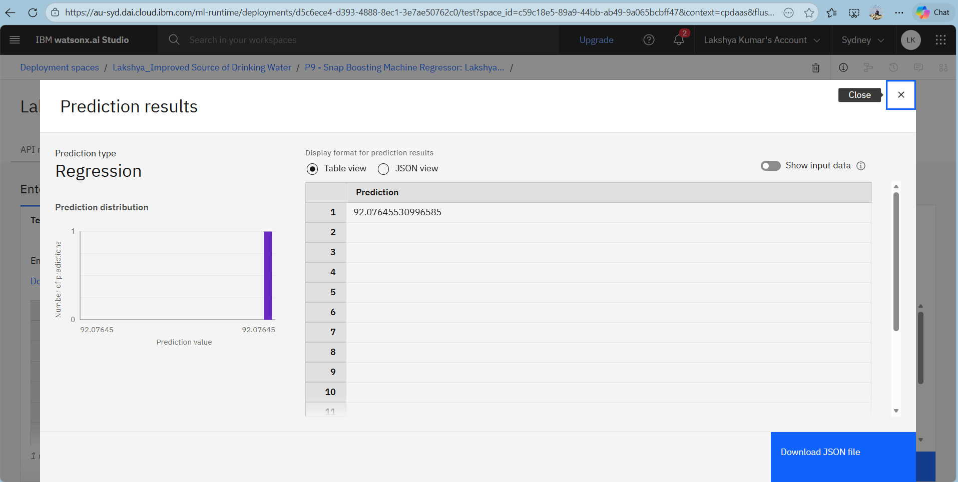
Result

Slide 23
Conclusion
Access to safe and improved drinking water varies significantly across regions and socio-economic groups in India.
Data-driven analysis plays a crucial role in identifying key factors influencing water accessibility, including infrastructure, clean energy usage, and migration patterns.
Targeted policies, focused infrastructure investments, and evidence-based planning are essential to achieve SDG 6 (Clean Water and Sanitation) and ensure equitable access to safe drinking water for all by 2030.

Slide 24
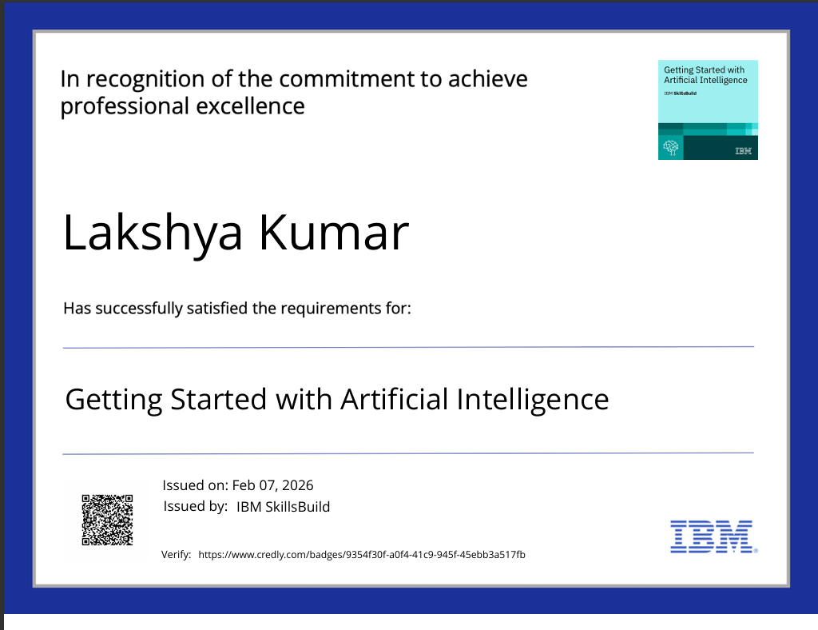
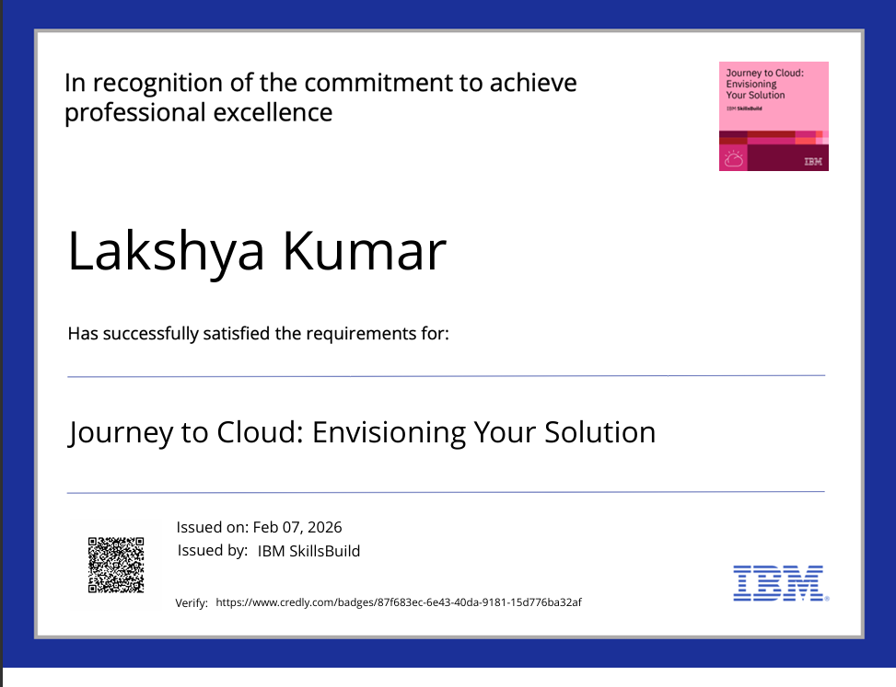
CERTIFICATE

Slide 25
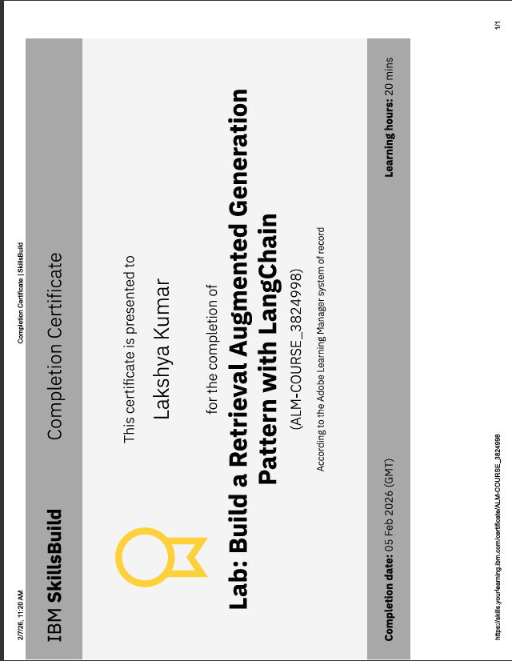
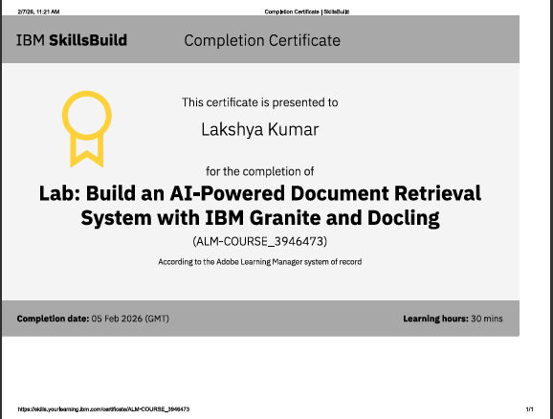
CERTIFICATE

Slide 26
THANK YOU

